Slide 1
Credit worthiness evaluation using Machine Learning
Prepared by:
Vidhi Chugh
19th Aug 2020

Slide 2
Contents
Business problem and data understanding
Train and test data distribution comparison
Exploratory Data Analysis
Categorical, missing values, outlier detection
Data Visualization
EDA Questions
Machine Learning pipeline
Model Interpretability
Predictions and Definition of credit worthiness learned by ML model
Comprehensive guide to elaborate selection criteria

Slide 3
Business problem: Credit worthiness Evaluation
Credit Risk: Risk of witnessing defaults on a debt that may arise from a borrower failing to make required payments.
Business Objective: To learn from the association between the traits and attributes of different borrowers in history and their repayment status i.e. whether it resulted in Good Risk or Bad Risk
Target Variable: Good (class 1, creditworthy) vs Bad (class 0, not creditworthy) Risk
Data* Description: 1000 records with 10 features
The dataset is divided into 90%-10%:
Train - 900
Test - 100
Column | Values
Credit History | 0 to 4
Age | 19 to 75
Gender | Male and Female
Job | 0 to 3
Housing | Own, rent and free
Saving Accounts | little, nan, quite rich, moderate, rich
Credit Amount | 250 to 15945
Duration | 4 to 72
Purpose | furniture/equipment', 'radio/TV', 'car', 'business', 'education', 'repairs', 'domestic appliances', 'vacation/others'
Risk | Good, Bad
Customers’ attribute
Loan specific attributes
Target Variable
* The data downloaded from the link did not have column headers, hence found discrepancies in column names and their values. This is a trimmed version of German Credit Risk data found by web search

Slide 4
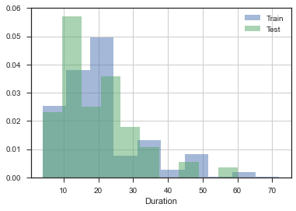
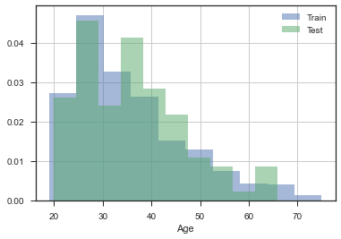
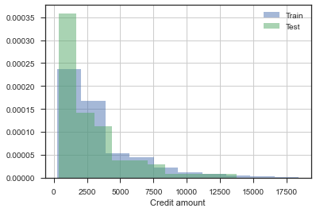
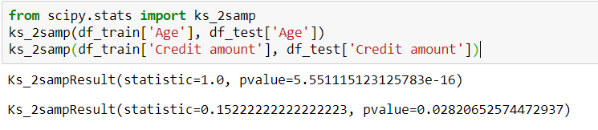
Generalization Power: train and test distribution similarity
One of the most critical assumption in ML data modelling is that train and test dataset belong to similar distribution, as is evident from graphs above. Note that the train data is used as a reference to estimate the future credit worthiness of customers, hence the ML solution is probabilistic one and not guaranteed based on past data. This emphasizes the property of generalization of ML solution
KS statistic is a numeric measure to check the hypothesis of whether the distributions of 2 dataset is same. For e.g. KS statistic > p value implies same distribution
Blue colour histogram is from Train data and Green colour is from Test data, the histogram plots from two distribution are sharing significant overlap with each other implying that there is no drift between the two datasets and that they are drawn from same distribution.

Slide 5
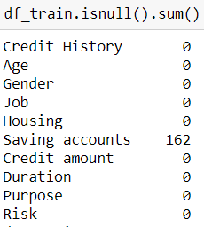
Exploratory Data Analysis
1) Missing Value Treatment
Only ‘Saving accounts’ has null, looking at the documentation, it implies that customer has ‘no account’, hence replaced nulls accordingly
2) Categorical Value Treatment
['Gender', 'Housing', 'Saving accounts', 'Purpose', 'Risk']
3) Outlier analysis
Feature | Cut off value | Instances
Credit amount | 11858 | 21
Age | 70 | 7
Duration | 57 | 12
The cut off value and corresponding number of instances falling out of 3 sigma are shown in the table to the right:
As these values look legitimate in the context of credit risk modelling, I am not treating them as outliers

Slide 6
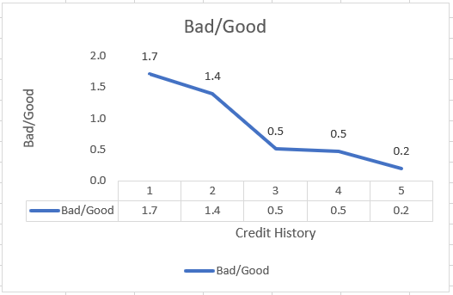
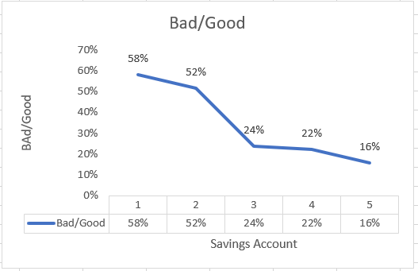
EDA Questions
Q1: More credit history is equivalent to credit worthiness
Credit History Class | Value counts Bad Risk** | Value counts Good Risk | Bad/Good
0 | 24 | 14 | 1.7
1 | 25 | 18 | 1.4
2 | 160 | 314 | 0.5
3 | 26 | 56 | 0.5
4 | 44 | 219 | 0.2
Class 3 and 4 (in %) | 25% | 44%
As proportion of class 3 and 4 increases from Bad Risk (25%) to Good Risk (44%) cases, the EDA signifies that credit history brings credit worthiness*. Further, the Bad/Good ratio in last column signifies that bad risk decreases as credit history improves
Q2: More saving accounts equivalent to more credit worthy?
Saving Accounts Class | Value counts Bad Risk | Value counts Good Risk | Bad/Good
0 | 199 | 343 | 58%
1 | 33 | 64 | 52%
2 | 31 | 131 | 24%
3 | 10 | 45 | 22%
4 | 6 | 38 | 16%
Class 3 and 4 (in %) | 6% | 13%
As proportion of class 3 and 4 increases from Bad Risk (6%) to Good Risk (13%) cases, we can infer that higher saving accounts class indicate better credit worthiness. Further, the proportion of Bad to Good cases across different saving accounts also shows that Bad Risk decreases with the higher Saving Accounts class.
.
Clear definition of credit history and saving accounts is needed to assert this pattern and conclude the inference
** Wherever % sign is not written is the count of instances in that bin

Slide 7
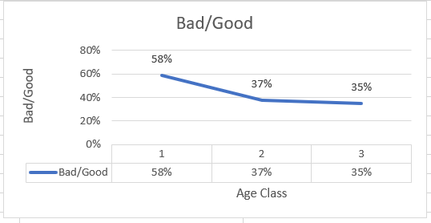

EDA Questions -- Continued
Q3: Are young people more credit worthy?
Dividing Age variable into following 3 brackets:
Age Class | Proportion/value counts Bad Risk | Proportion/value counts Good Risk | Bad/Good
0 | 138 | 236 | 58%
1 | 94 | 251 | 37%
2 | 47 | 134 | 35%
As evident in the chart, the proportion of Bad with respect to Good shows a downward trend as the Age increases, hence we conclude that aged people default lesser number of times which in turn says, young people have more tendency to default
Rationale behind creating such Age bins:
Age < 30: Could comprise of Loan seeking, affluent spenders
30<Age<45: Generally consists of married people seeking financial security for family, or as an investment vehicle
Age>45: Averse to seeking loans, in general (could have made this to Age 50, but sample size would have gone smaller)

Slide 8
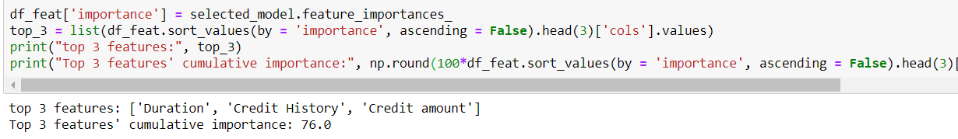
Machine Learning Pipeline
5-fold cross validation
 | Fbeta score Mean | Fbeta score Sigma
Decision Tree | 74% | 2.5%
Random Forest | 76% | 1.8%
Logistic Regression | 75% | 1.3%
Decision Tree
Random Forest
* Fbeta score: Weighted harmonic mean of Precision & Recall,
where beta = weight on Recall (here, beta = 1/5)
* Model Selection criteria is explained in detail in next slide
Input training data
EDA
Categorical features Treatment
Null value treatment of 'Saving accounts’
Outlier analysis of 'Age’, 'Duration’ and 'Credit amount’
Logistic Regression
Candidate Classification Algorithms
Predicted as Good Risk
Shap explainability framework
Trained model
Test data

Slide 9
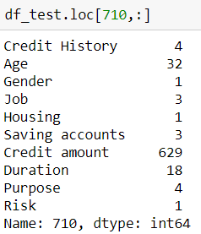
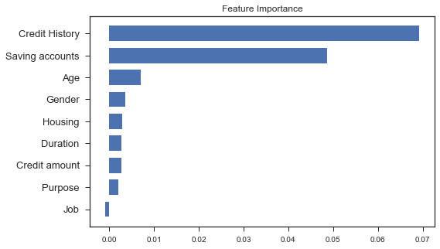
Prediction and Definition of credit worthiness learned from pattern recognition via Machine Learning
Trained model
Shap framework
Test row aka profile of new customer applying for loan
Local feature importance takes the out of sample/unseen data of new customer applying for loan. Based on learned associations, trained model predicts the probability of risk of this customer (710). Now comes the main part: Why??
Credit History→ Class 4: signifies confidence
Saving Accounts→ Class 3: like credit history (the higher the better)
Global feature importance considers interactions of all historical customer profiles who availed loan wrt their repayment status (classified as Risk vs Good Risk)
As per selected model, Duration, Credit History, Credit Amount are the key attributes

Slide 10
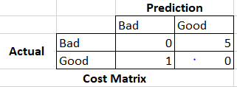
Model Selection Criteria
F score is generally used as evaluation metric when there is no preference between Recall and Precision
2PR/(P+R), where
P: Precision: focus on reducing False Positives (FN)
R: Recall: focus on reducing False Negatives (FN)
Relevance of importance of Recall vs Precision in our example:
As per the given report, there is a cost on classifying the customer as good when they are bad, i.e. predicting Good Risk (class 1, positive class) when it is False i.e. False Positives (FP) draw heavy penalty based on our business objective
Precision = TP/(TP+FP), so our goal is to prioritize Precision which in turn will reduce the FP
Had the objective been to give penalty on predicting bad when they are good i.e. based on ML recommendations, we are refraining from lending, we would have lost business.
In that case, the focus would be on False Negatives i.e. you are predicting Bad Risk (class 0, negative class) while the customer was in Good Risk category. So, we predicted negative which went wrong implying lesser FN, which in turn would lead to more weight on Recall (TP/TP+FN)

